Slide 1
Deep Neural Networks
Why deep
representations?

Slide 2
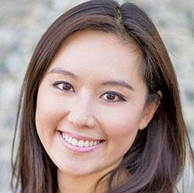
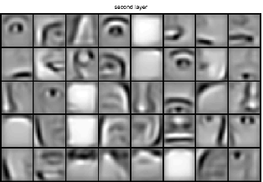
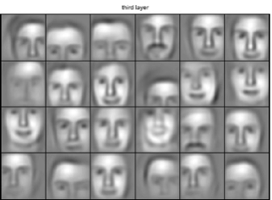

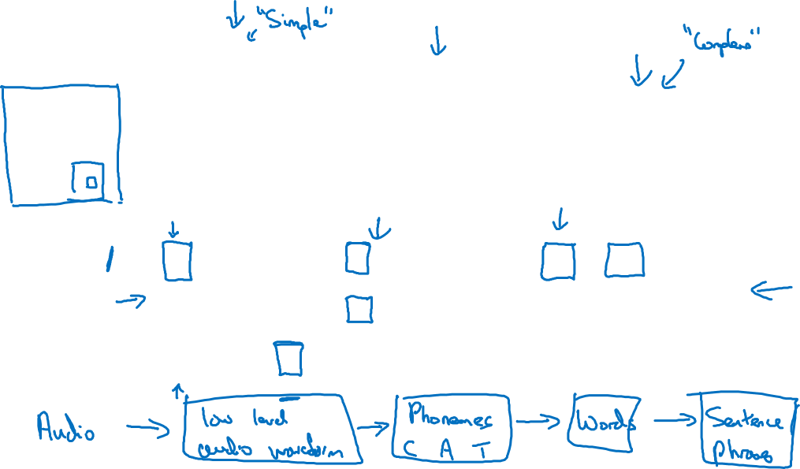
Intuition about deep representation
$$\hat{y}$$

Slide 3
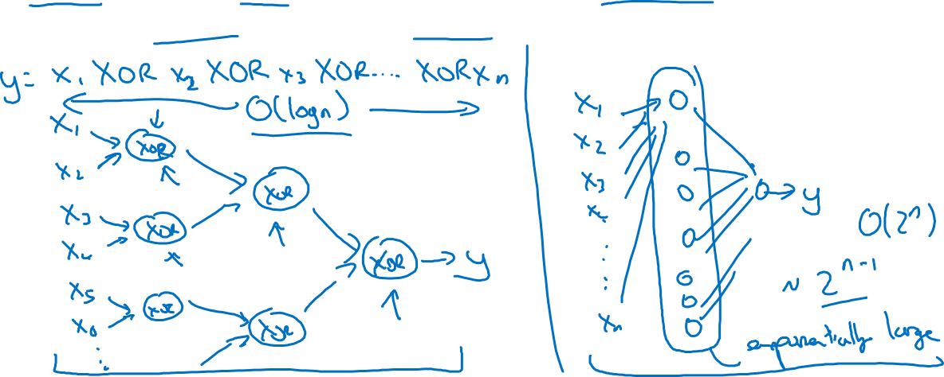
Circuit theory and deep learning
Informally: There are functions you can compute with a “small” L-layer deep neural network that shallower networks require exponentially more hidden units to compute.

